Slide 1
More Mobility
Shivam Mahtani, Frederick Saunders, & Aarya Shah

Slide 2
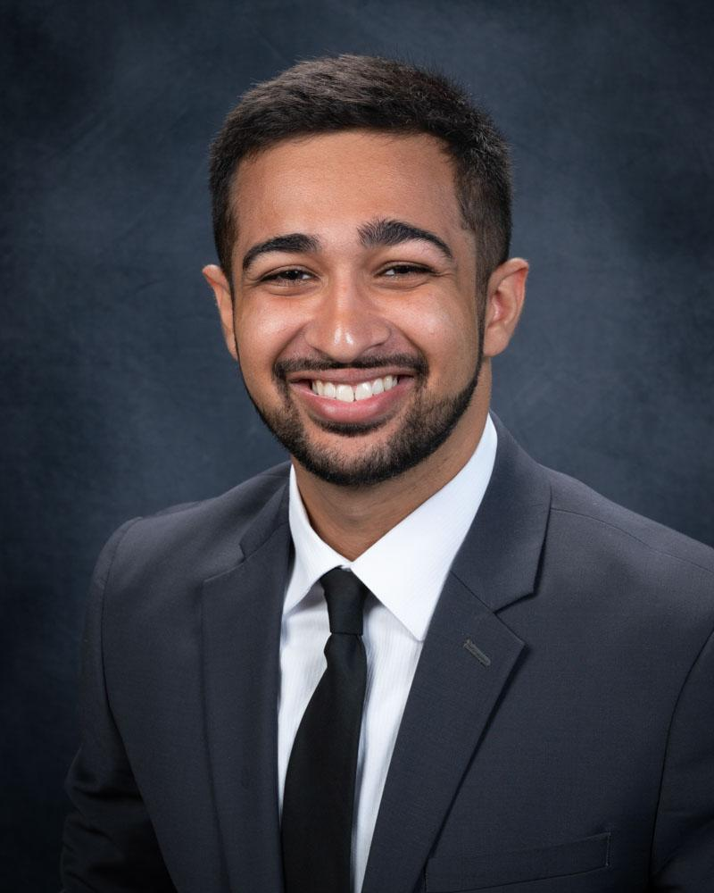


Meet the Team
Shivam Mahtani
Junior Biomedical Engineer
Aarya Shah
Sophomore Mechanical Engineer
Frederick Saunders
Junior Biomedical Engineer
Sponsor:
Courtney Moore
Assistant Vice President, Terminal Experience DFW
Mentor:
Dr. Gary Cecchine
Director of Research, RAND Gulf States Policy Institute

Slide 3
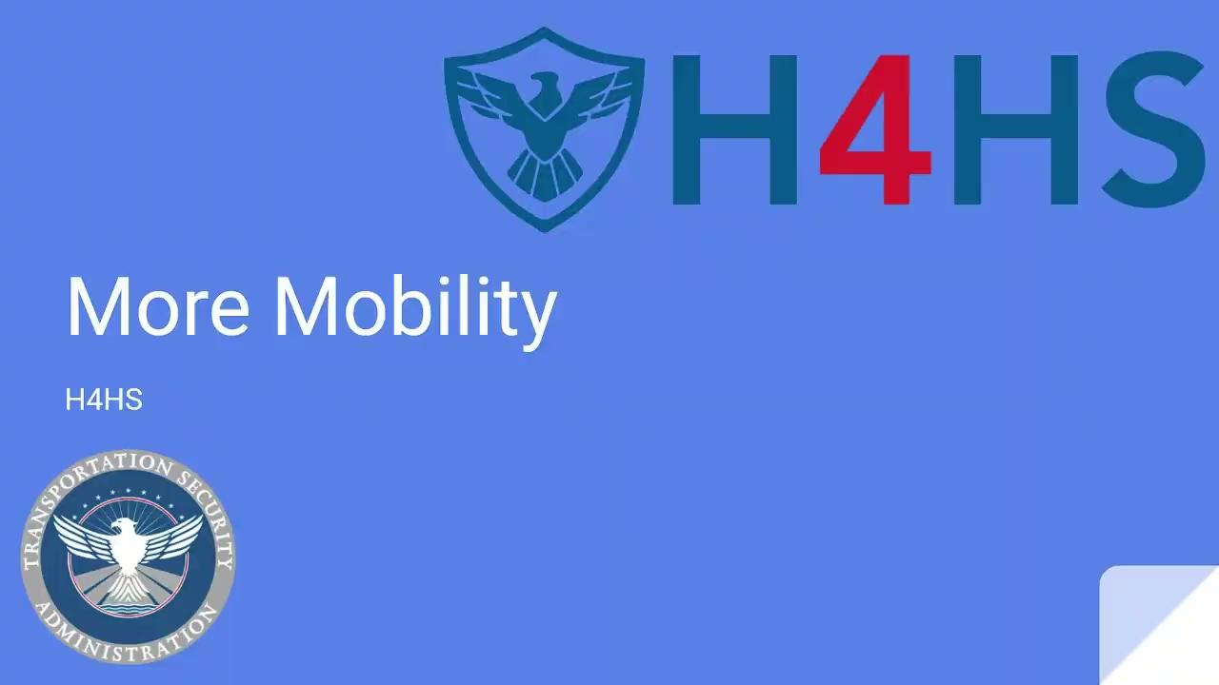

Slide 4
The Problem:
Transportation Security Managers at TSA must pat down individuals in wheelchairs, causing discomfort, distrust, frustration, and reduced efficiency in lines. By screening those individuals at a faster rate, TSMs, disabled passengers, and non-disabled passengers will be more satisfied with a quicker, less congested screening process.

Slide 5
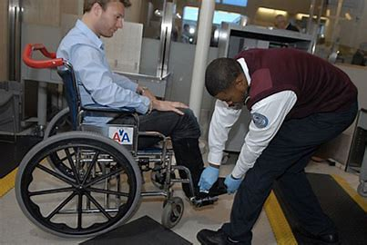
Existing Solutions
Pat-Downs
Limitations: Inefficient, uncomfortable, and time consuming (10 min Per Pat Down)
2. Asking for User to Stand and Be Scanned
Limitations: Ethical issues, wasted time, Prospect left waiting

Slide 6
Customer Discovery

Slide 7
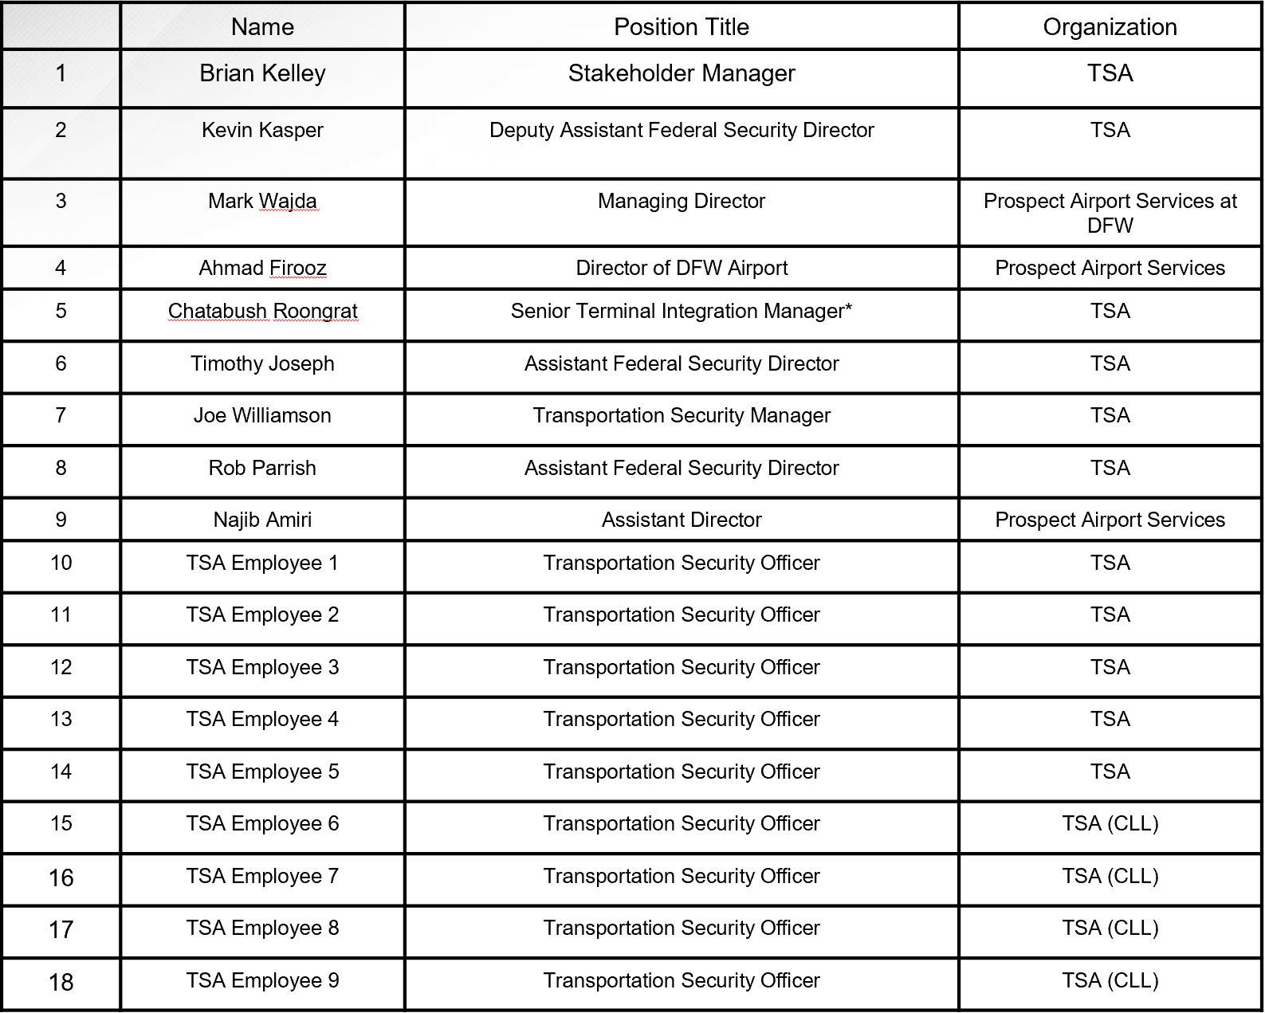
Customer Discovery

Slide 8
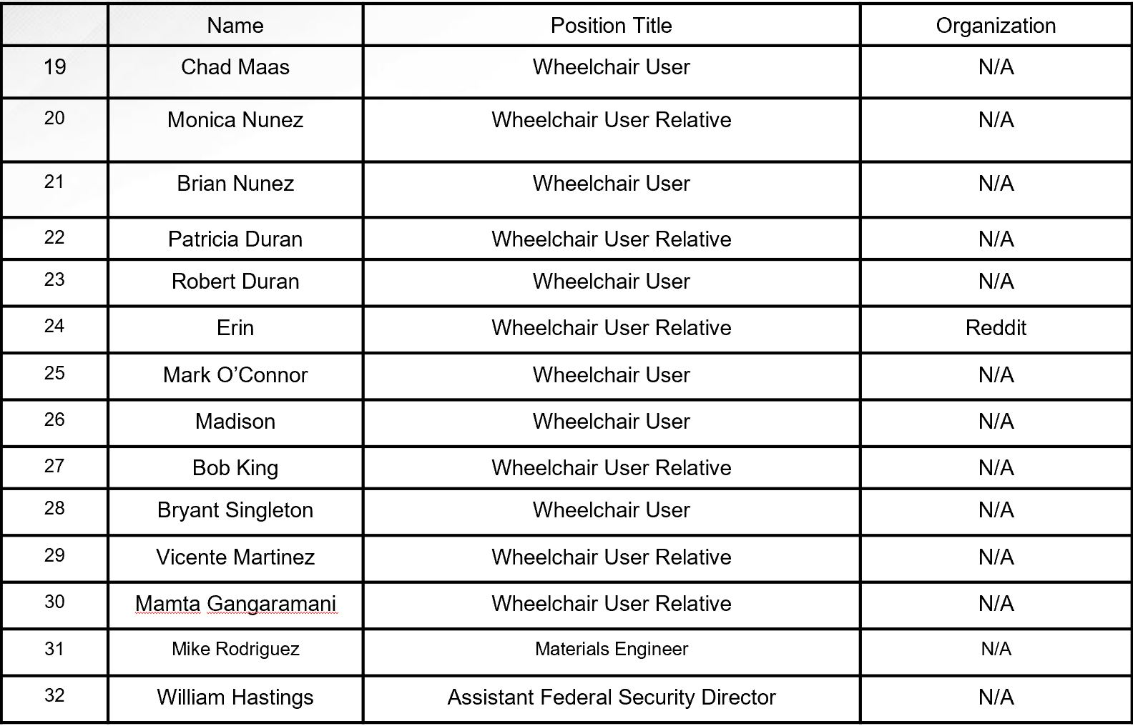
Customer Discovery (Continued)

Slide 9
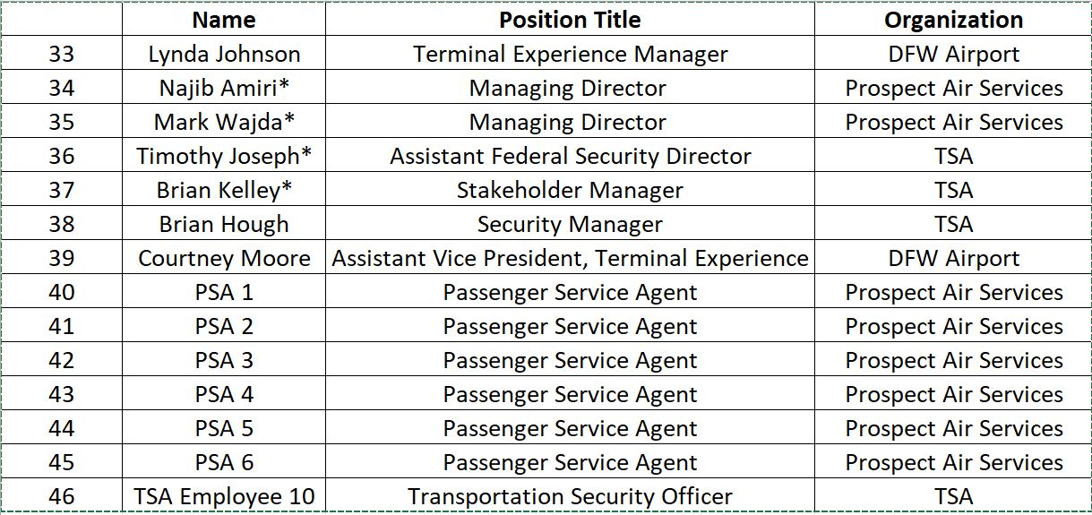
Customer Discovery (Continued)

Slide 10
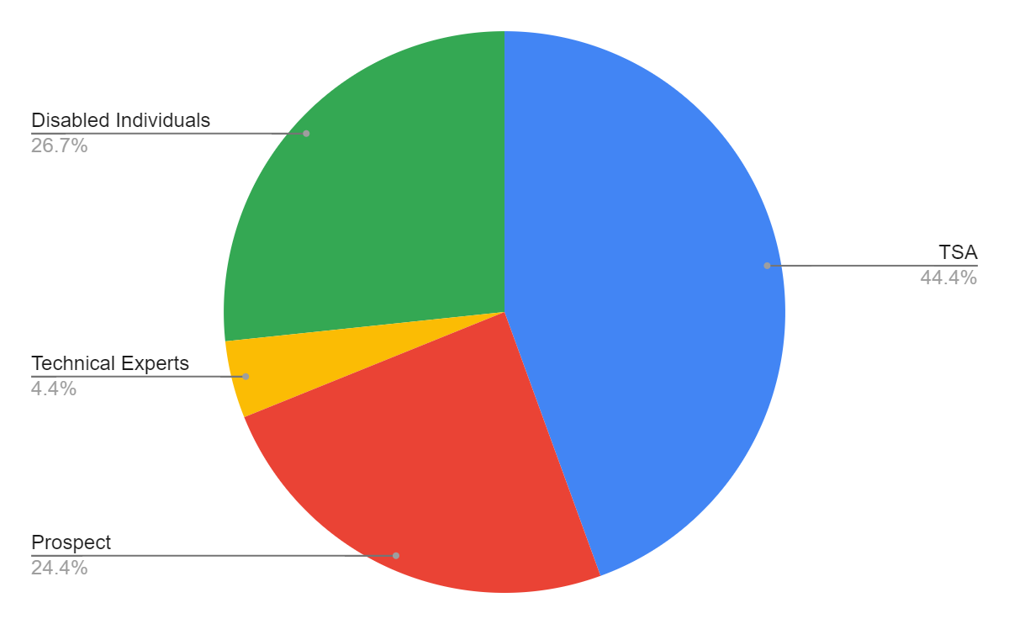






Customer Discovery

Slide 11
Customer Hypothesis
We believe Transportation Security Managers are frustrated by lengthy screening times of mobility disabled people because of the inefficient pat-down process

Slide 12
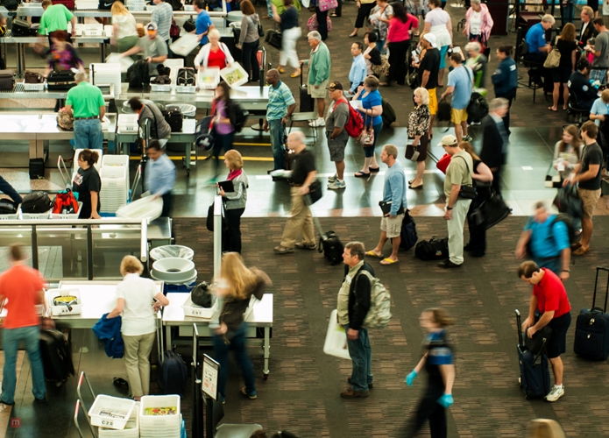
Our Path
Original hypotheses
  Is an efficiency plan or architectural layout change the most optimal solution?
  An actual product/prototype isn’t viable
  The more employees present, the better the system would flow
Findings
  On the “back-burner” since TSA’s creation, but always an issue
  Cluster of people makes security presence more difficult
  A product/prototype actually would help the most
  Many wheelchairs left stranded around airport
  Wheelchairs used as language barrier in international
terminal

Slide 13


Beneficiary Discovery
Other Travelers:
TSA/Airport:
Attendants:
Wheelchair Users:
TSOs (Officers)
TSA Cares Specialists
TSA Management
Airport Management
Friends/Family
Prospect Services
Airline Attendants
TSA Cares Program
Solo Travelers
Elderly Travelers
Foreign Travelers

Slide 14
Customer Value Proposition
Beneficiary | Value Proposition
TSA Agents (TSO) Wheelchair Users TSA Managers (TSM) | Reduces time & effort required for screening people with wheelchairs, minimizing effort required in a workday. Minimizes humiliation going through TSA Saves time spent in security when traveling. Reduces time waiting for baggage. More efficient passenger flow through terminals. Security overall is much easier to handle and oversee.
Archetypes of Customer:
TSO’s: Typically middle aged and male, middle class
Wheelchair users: Usually older age
TSM’s: TSA employees who have been there many years, upper middle class

Slide 15
Unique Value Proposition
We aim to help Transportation Security Managers
solve the inefficiencies in the screening procedure of mobility disabled individuals by providing a combination of a new wheelchair and a revised screening method.
Metric: Average Screening Time, $ saved/day

Slide 16
Mission Model Canvas

Slide 17
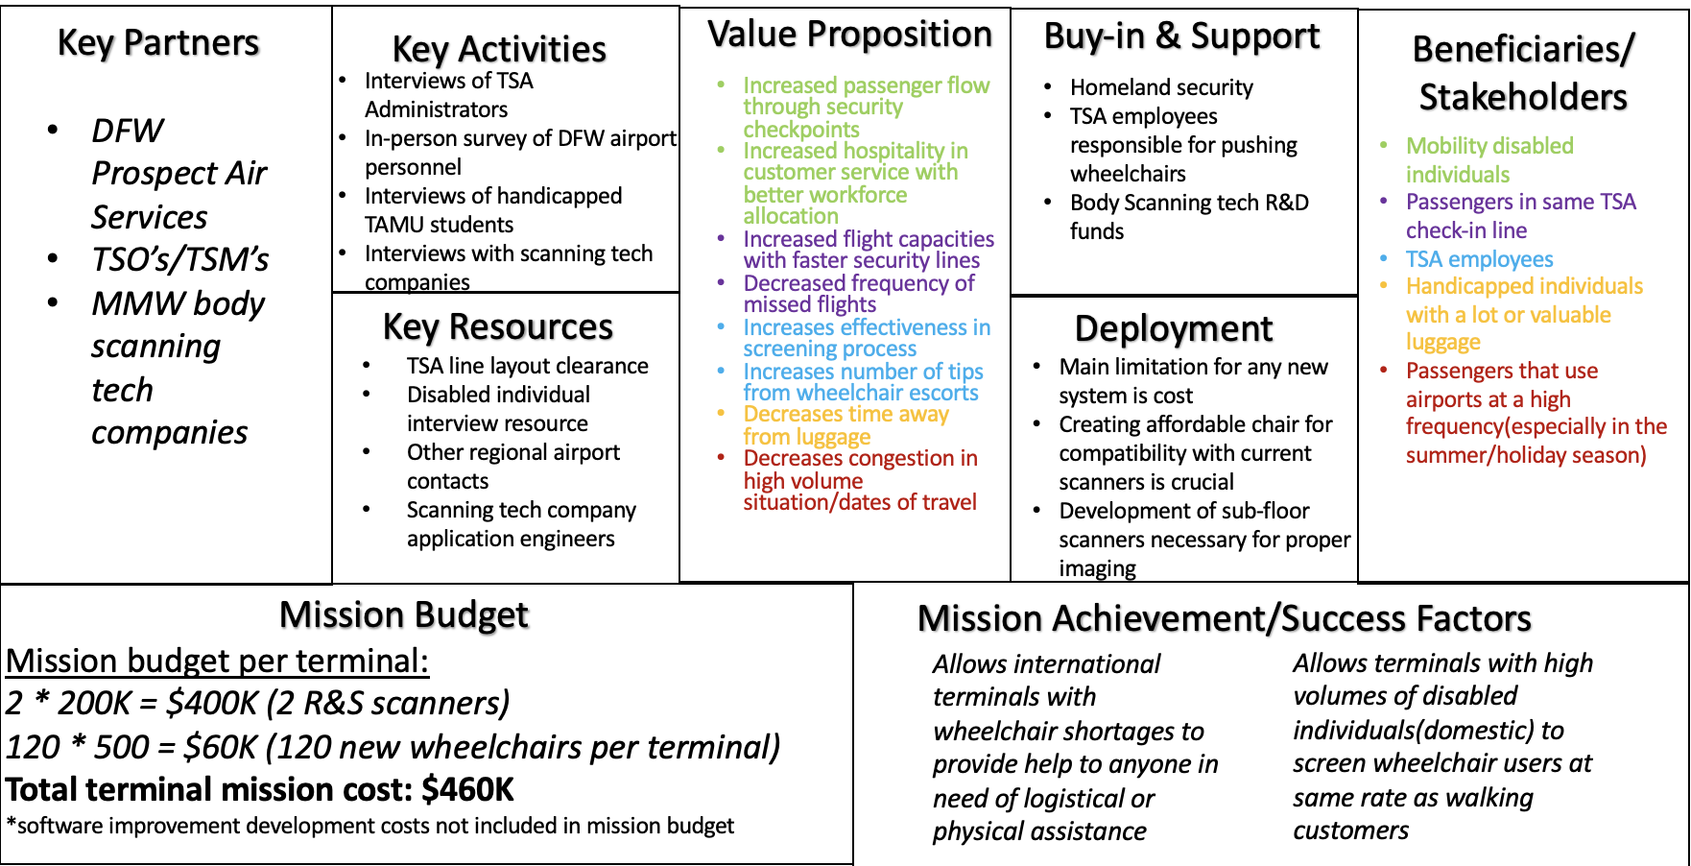
MMC Overview

Slide 18
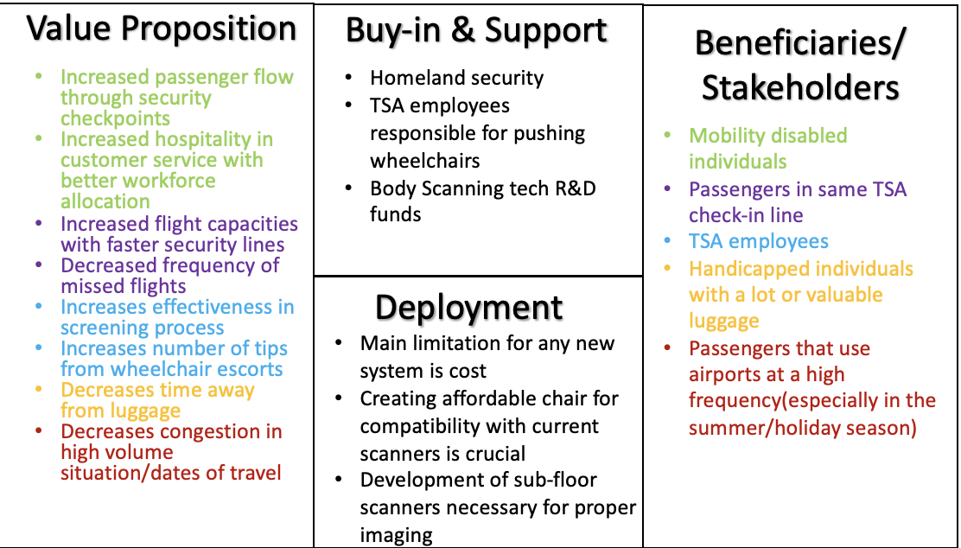
Desirability

Slide 19
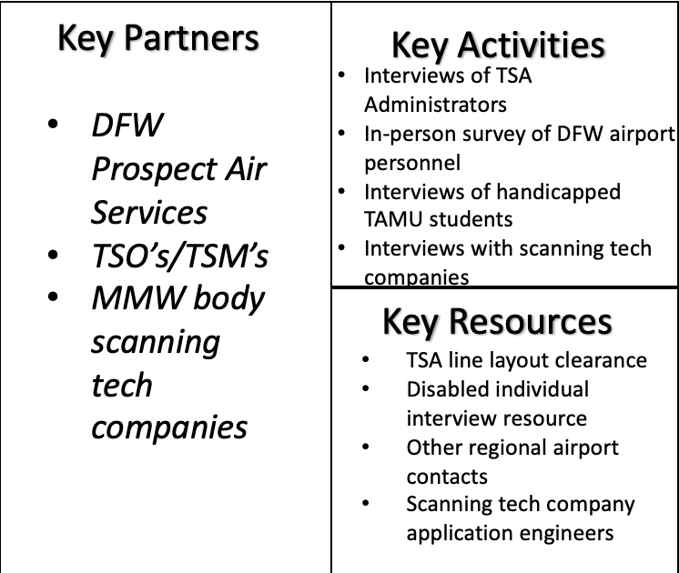
Feasibility

Slide 20
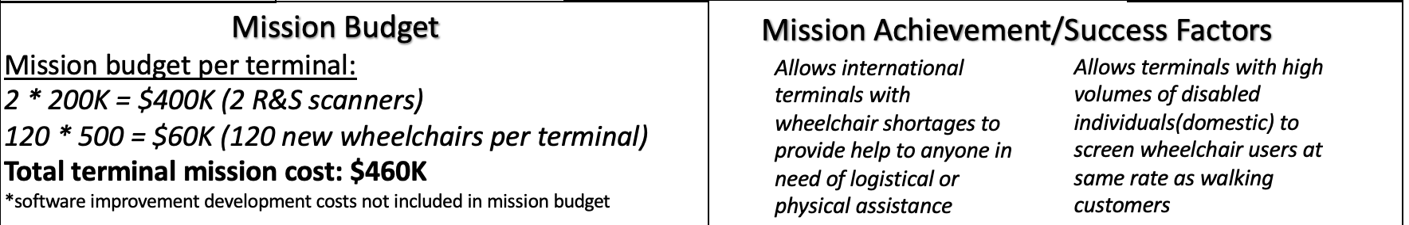
Viability

Slide 21
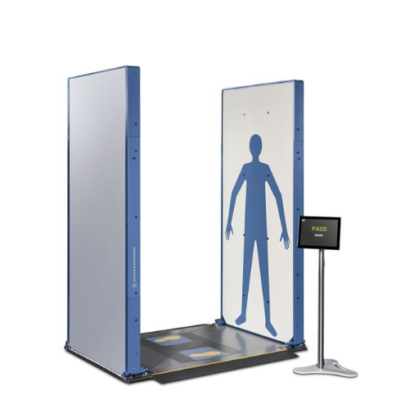
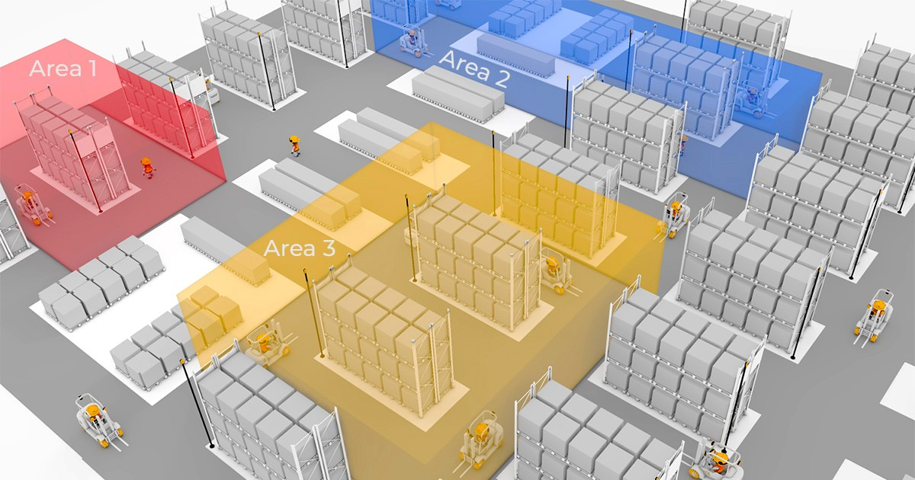
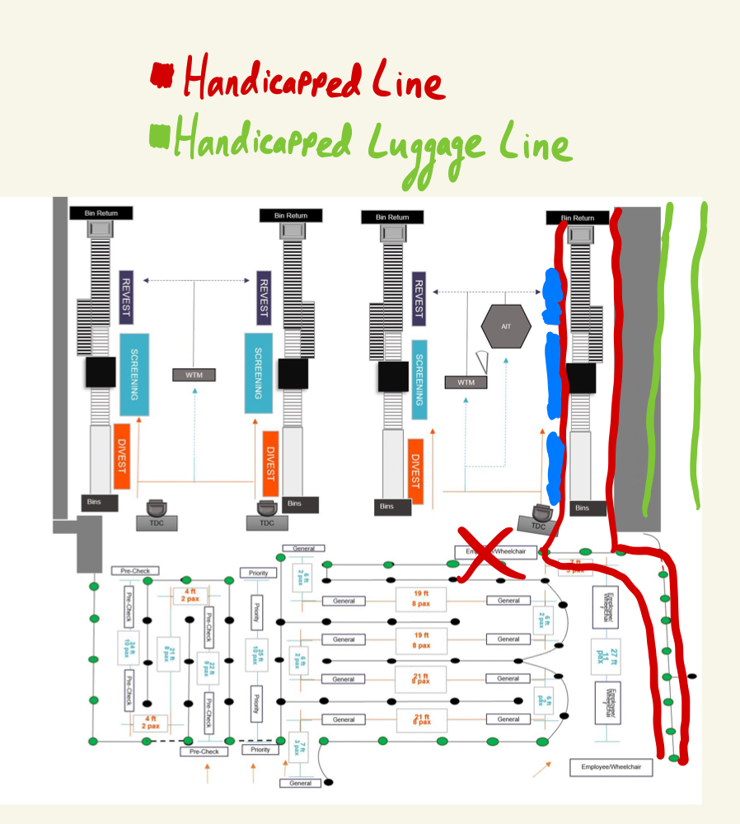
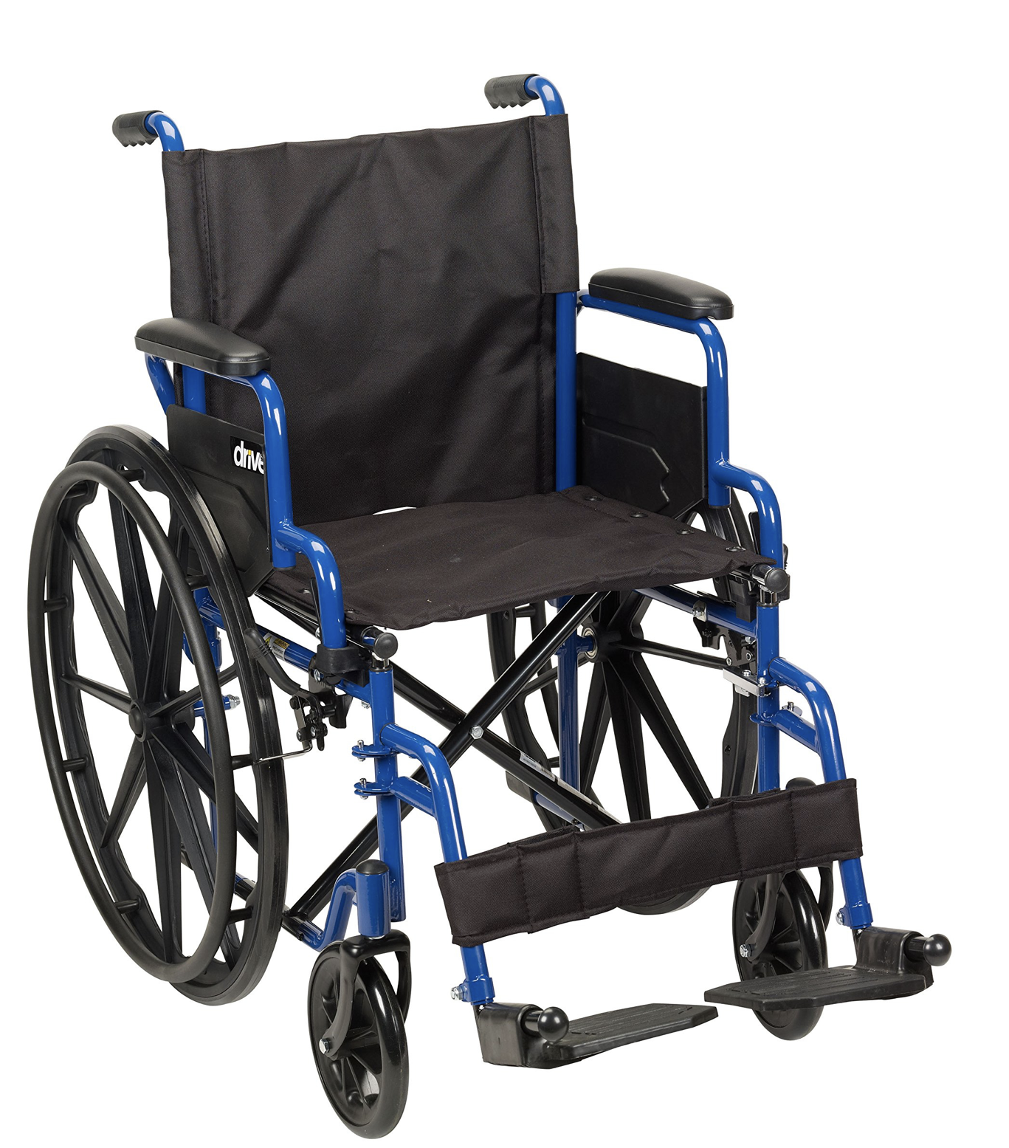
Minimum Viable Product - Visual
Geofencing Installed
Current MVP
Initial MVP
Polypropylene & Canvas
Floor Scanner

Slide 22
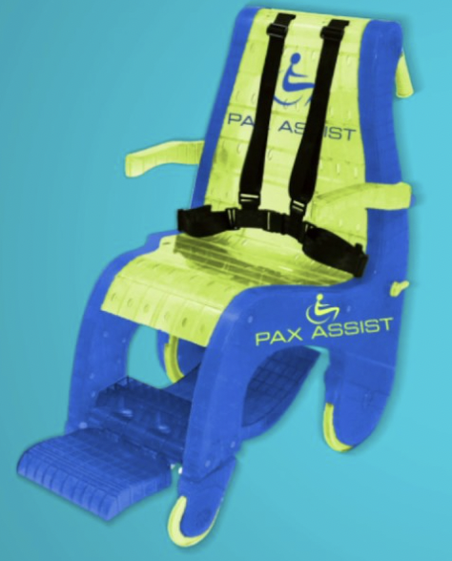
Minimum Viable Product - Explained
Wheelchair Data:
Improved design of Pax Assist Wheelchair
New scanner along with floor scanner allows for remained seating
Geofencing:
Tracking chip placed in each wheelchair
Software developed that organizes DFW into “areas”
System trained to track wheelchair through each area
Hubs around airport for ease of organization
Pax Assist Wheelchair mentioned by Prospect personnel:
https://paxassist.com/flight-passenger/

Slide 23

Minimum Viable Product - Support
Estimated Cost Savings:
Terminal D work hours saved:
500 Wheelchair customers x 2 TSO’s required x ⅙ hours per pat-down = 167 Hours
167 hours x 25% Need Pat-Down = 41.75 hours x 365 days = 15240 hours/year
15240 hours/year x $30/hr (Avg. TSO salary) = $457,200/year for Terminal D
Cost:
Rohde-Schwarz QPS 12 — $200,000 per unit (2 per terminal)
*Not inclusive of software changes
Plastic Wheelchair — $500 per unit (120 per terminal)
Total: $460,000
International Terminal:
Wheelchairs are used because of language barriers and need attendants’ help
Efficiency system of moving international crew reduces time
Domestic Terminal:
People who use wheelchair services more than likely need them
Geofencing and cheaper wheelchair means more supply and easy tracking for Prospect
Notes:
500 Wheelchairs/terminal÷ 6 Wheelchairs/hour (10 minute/chair) x 2 agent x $25/hr
= ~$6000 per day/terminal = ~$30,000 per day
= ~$2MM per year/terminal = ~$10.95MM per year

Slide 24
Proposed Implementation Plan
Goal for Next 3 months
Build & Test proposed wheelchair
Research & Develop floor scanning technology
Implement Rohde-Schwarz QPS 12 in 1 checkpoint at DFW
Goal for Next 9 months
Scale up to entire international terminal
Increase wheelchair manufacturing capacity
Goal for Later
Implement system and tech in all terminals at DFW
Potentially expand to other airports

Slide 25

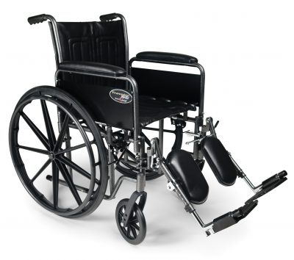
Narrative Arc
Enthusiasm
Working with TSA
Funding
Many resources
Frustration
Ghosting
No clear-cut solution
Trip scheduling
Insight
Potential MVP
Verification coming soon
Learning
New scanning tech
Wheelchair material
interviews

Slide 26
Lessons Learned
Aarya:
  Interview Skills: Learning to connect with people as an interviewer
  “H4HS has helped me better understand the process of researching a problem through a wide range of stakeholder groups.”
Shivam:
  Connectivity: Making connections/reaching out to new people to learn and get insight
  “H4HS taught me to expand my knowledge and thinking past Biomedical Engineering and utilize it in different aspects.”
Frederick:
  Innovation: taking what was learned from each interview and figuring out how to use it to enhance our MVP
  “H4HS helped me explore new opportunities around my field.”

