Slide 1
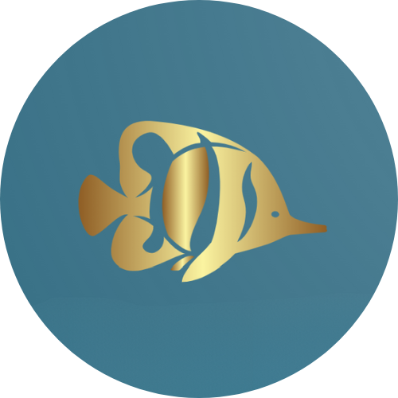

Andrii Kryvenko, Aarya Shah, Liktha Joneboina,
Raisa Karnik, Sara Angarita, Zachary Hill
Notes:
ZebraFish is an integrated software and hardware solution designed to enhance the quality control and defect detection capabilities of metal 3-D printing processes. It combines advanced sensors, artificial intelligence, and automated repair mechanisms to revolutionize the industry. Here's how it works:

Slide 2
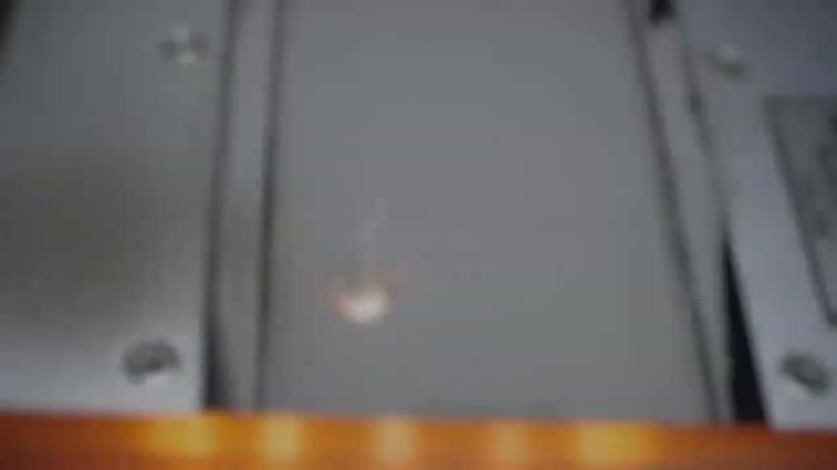

Slide 3
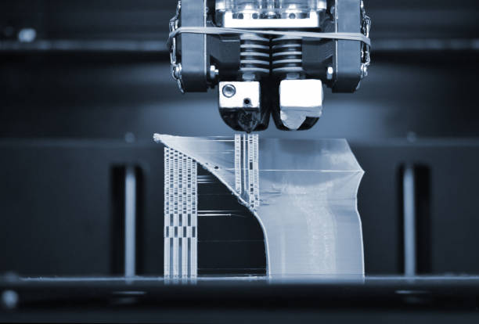
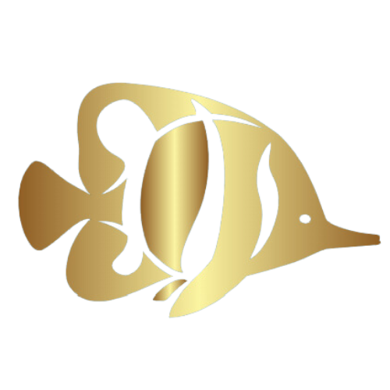
Current
Defect found
Printer automatically stops

Slide 4
The Need

Slide 5
Design Requirements
1
2
3
Non-Invasiveness
Durability
Reliability
4
5
Accuracy
Cost-Efficiency

Slide 6
Proposed Solutions
Imaging Sensors
Voltage Resistance & Variance
Failsafe
01
02
03
Notes:
Thermal:
Collect temperature data with a high resolution & compare to the established cooling profile of the metal
Ultrasonic:
Generate a 3D map of the layer using sonar pings & distance data
Determine deviation from a

Slide 7
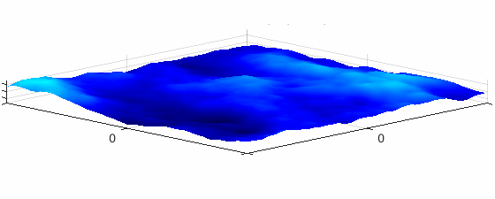
Our Solution
Detect defects in the 3D printed metals lifecycle using thermal imaging and ultrasonic mapping.
Notes:
ZebraFish is an integrated software and hardware solution designed to enhance the quality control and defect detection capabilities of metal 3-D printing processes. It combines advanced sensors, machine learning, and automated repair mechanisms to revolutionize the industry.

Slide 8
Advanced Sensors
01

Slide 9
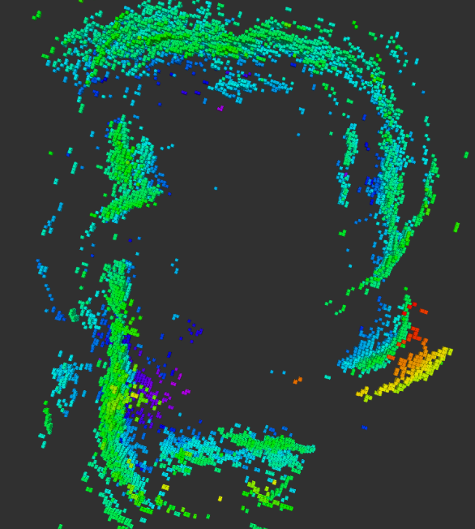
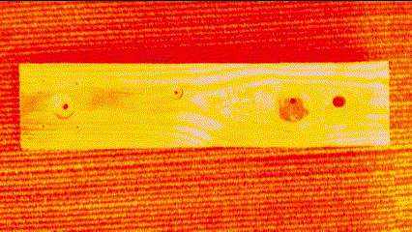
Rapid Data Collection
Thermal Imaging
Ultrasonic Sensor
Artificial Intelligence
Track the cooling profile of the part
Generate a 3D map of the print
Rapid Processing of Sensor Data
Notes:
Thermal:
Collect temperature data with a high resolution & compare to the established cooling profile of the metal
Ultrasonic:
Generate a 3D map of the layer using sonar pings & distance data
Determine deviation from a

Slide 10
Machine Learning
02

Slide 11
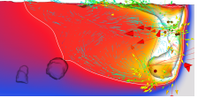
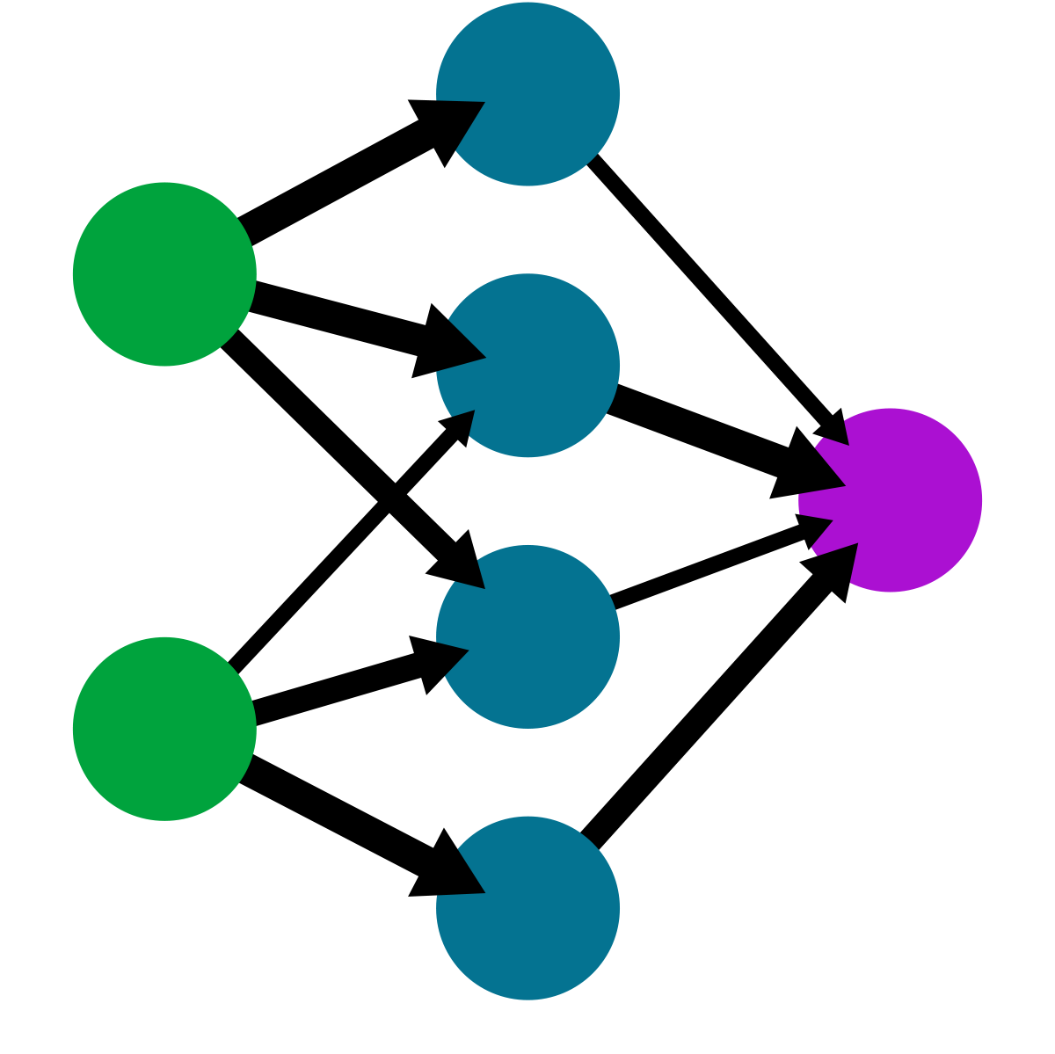
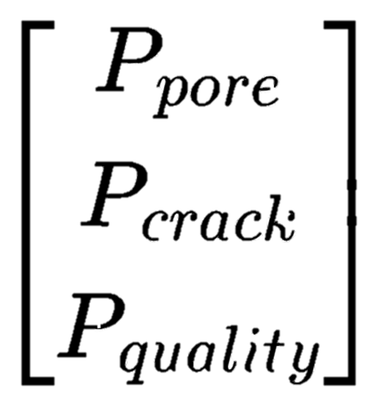
Data Collection
Defect Detection
Notes:
Incorporating artificial intelligence will redefine defect detection in 3D printing, optimizing efficiency and allowing for real-time repair. Data will be collected from thermal imaging, which measures heat profiles, and ultrasonic, measuring the presence and absence of material, third party sensors on metal 3D printers. This will allow us to detect three main defects: porosity, cracks, and overall surface area. A multiclass CNN model will train on thermal and range data at points to detect the presence of a defect and subsequently classify the defect in a probability matrix as the output. This information is then used to trigger real-time repair: the 3D printer will traverse over the area of defect, eliminating the probability of defects before continuing. Given that accuracy increases as more data is input into the neural network, our algorithm will meet current research findings of about 97% accuracy in detecting defects.

Slide 12
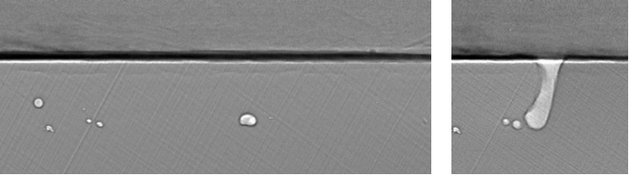
Data Collection
Defect Detection
Real-time Repair
Notes:
Incorporating artificial intelligence will redefine defect detection in 3D printing, optimizing efficiency and allowing for real-time repair. Data will be collected from thermal imaging, which measures heat profiles, and ultrasonic, measuring the presence and absence of material, third party sensors on metal 3D printers. This will allow us to detect three main defects: porosity, cracks, and overall surface area. A multiclass CNN model will train on thermal and range data at points to detect the presence of a defect and subsequently classify the defect in a probability matrix as the output. This information is then used to trigger real-time repair: the 3D printer will traverse over the area of defect, eliminating the probability of defects before continuing. Given that accuracy increases as more data is input into the neural network, our algorithm will meet current research findings of about 97% accuracy in detecting defects.

Slide 13
Failsafe
03

Slide 14
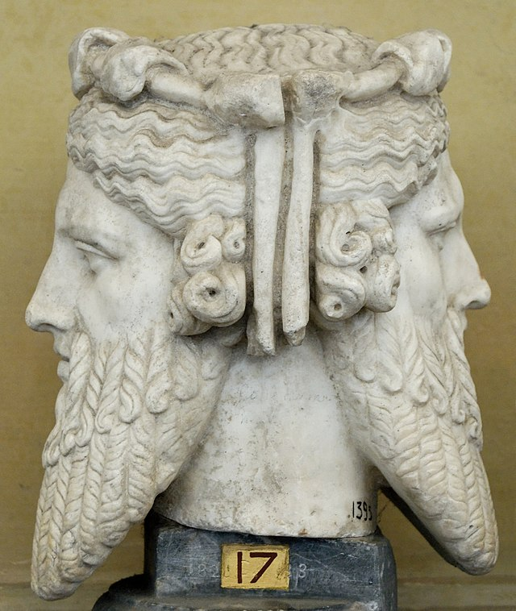
Janus Nanoparticles
A
B
Hydrophobic
Lipophilic

Slide 15
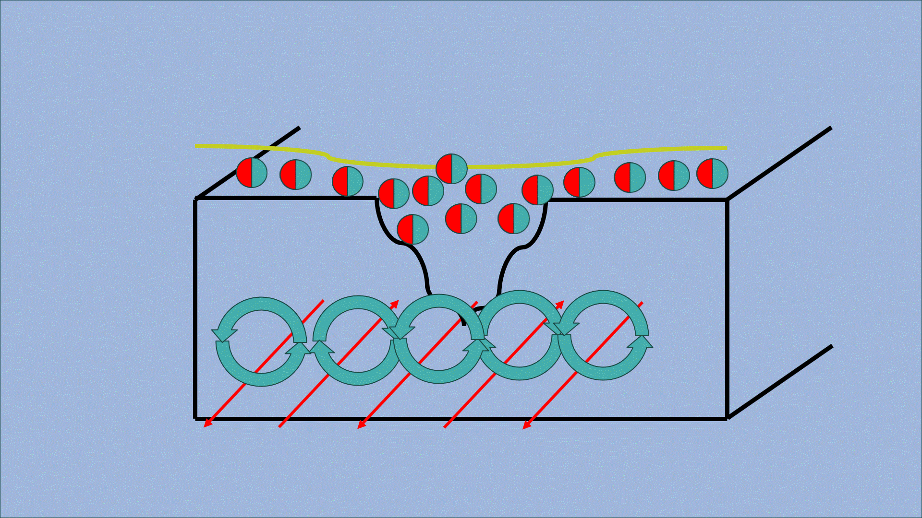
Resources

Slide 16
Thank you

